Slide 1


Signals & Systems for Computer Engineering
Prof.Dr. B.Berk ÜSTÜNDAĞ
Istanbul Technical University
Faculty of Computer Engineering and Informatics
BLG354E / CRN: 21615
6th Week Lecture (cont.)
2020
bustundag@itu.edu.tr
BLG354E / CRN: 21560
6th Week Lecture (cont.)

Slide 2
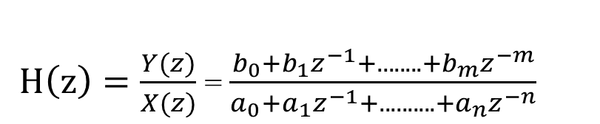
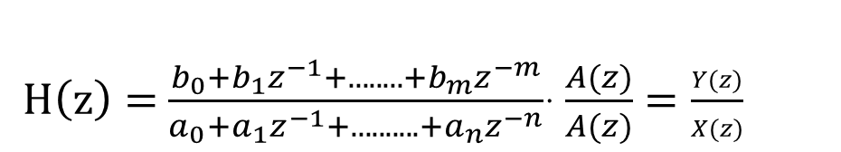
Implementation of Discrete Time Systems
Transfer function of DT-LTI system is given as,
$H\left(z\right)=\frac{Y(z)}{X(z)}$ = $\frac{b_{0}+b_{1}z^{−1}+........+b_{m}z^{−m}}{a_{0}+a_{1}z^{−1}+..........+a_{n}z^{−n}}$
$H\left(z\right)=$ $\frac{b_{0}+b_{1}z^{−1}+........+b_{m}z^{−m}}{a_{0}+a_{1}z^{−1}+..........+a_{n}z^{−n}}$· $\frac{A(z)}{A(z)}=\frac{Y(z)}{X(z)}$
Y(z) =
( b₀ + b₁z⁻¹ ......+b_{m}z^{-m}) A(z)
A(z) =
X(z) -
(a₁z⁻¹+a₂z⁻²+...........+a_{n}z^{-n}) A(z)
BLG354E - İTÜ Faculty of Computer Engineering and Informatics - Üstündağ

Slide 3








Direct Programming
(canonical form)
$$\frac{b0}{a0}$$
$$\frac{b1}{a0}$$
$$\frac{b2}{a0}$$
X[z]
x[n]
$$\frac{1}{a0}$$
A
B
C
$$\frac{bm}{a0}$$
y[n]
+
z⁻¹
z⁻¹
z⁻¹
+
$$\frac{−a1}{a0}$$
$$\frac{−a2}{a0}$$
$$\frac{−an}{a0}$$
Unit delay (remember):
z⁻¹=e^{-sT} where s=jω
A
B
z⁻¹
B=A·z⁻¹ ⇒ B(k)=A(k-1)
BLG354E - İTÜ Faculty of Computer Engineering and Informatics - Üstündağ

Slide 4


Example:
H(z) = $\frac{Y (z)}{X (z)}$ = $\frac{5(1+2z^{−1})}{(1−z^{−1})(1−0.5z^{−1})}$
Write the Psuedo code H(z) for the signal sampled at f_{s}
H(z) =$\frac{Y(z)}{X(z)}$= $\frac{\left(5+10z^{−1}\right)A(z)}{\left(1−1.5z^{−1}+0.5z^{−2}\right)A(z)}$
Y(z) = ( 5 + 10 z⁻¹) A(z)
A(z) = X(z) + 1.5 z⁻¹ A(z) - 0.5z⁻² A(z)
5
Pseudo code:
Timer Interrupt @Ts=1/f_{s}
X = READ (ADC)
A = X + 1.5 B – 0.5 C
Y = 5 A + 10 B
Output (Y)
C=B
B=A
Return
10
x[n]
B
C
y[n]
+
z⁻¹
z⁻¹
+
A
1.5
-0.5
BLG354E - İTÜ Faculty of Computer Engineering and Informatics - Üstündağ

Slide 5
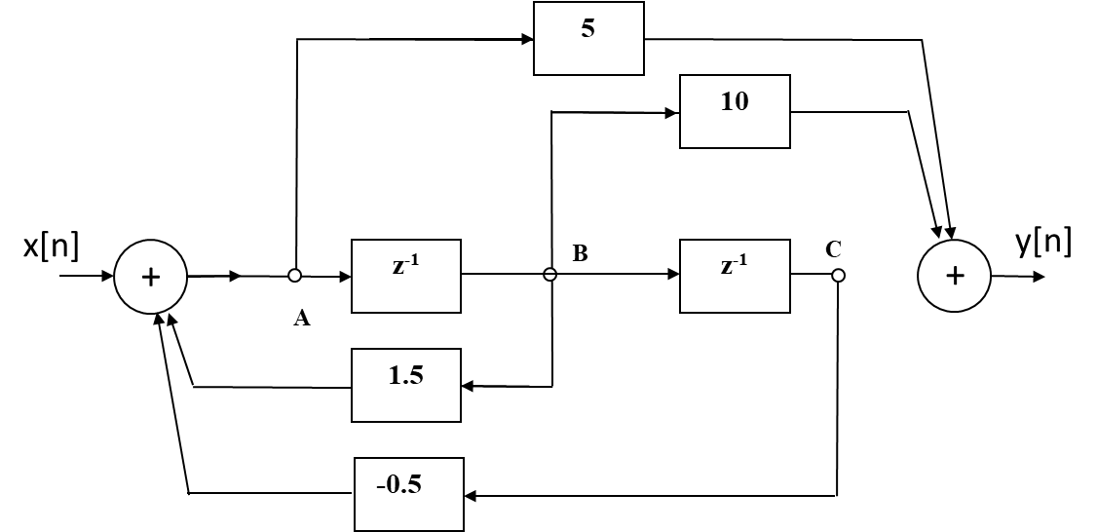
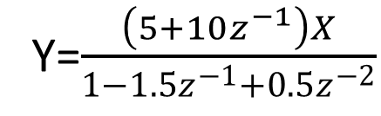
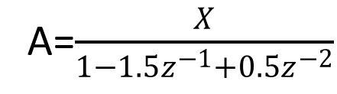
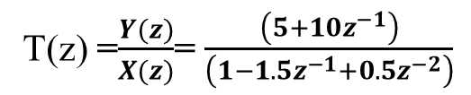
Proof:
Y=5A+10B=
=5A+10Az⁻¹=(5+10z⁻¹)A
A=X+1.5B-0.5C
A=X+1.5Az⁻¹-0.5Az⁻²
A=$\frac{X}{1−1.5z^{−1}+0.5z^{−2}}$
Y=$\frac{\left(5+10z^{−1}\right)X}{1−1.5z^{−1}+0.5z^{−2}}$
T(z) =$\frac{Y(z)}{X(z)}$= $\frac{\left(5+10z^{−1}\right)}{\left(1−1.5z^{−1}+0.5z^{−2}\right)}$
BLG354E - İTÜ Faculty of Computer Engineering and Informatics - Üstündağ

Slide 6
Step Response:
for n<0 x[n]=0 ⇒ y[n]=0
for n≥0 x[n]=1
x[n]=u[n]
Input X
A = X + 1.5 B – 0.5 C
Y = 5 A + 10 B
C=B
B=A
Output Y
Return
@T_{s}
t=n·T_{s}
Initial condition
n | x[n] | A | B | C | y[n]
0 | 1 | 1 | 0 | 0 | 5
1 | 1 | 2.5 | 1 | 0 | 22.5
2 | 1 | 4.25 | 2.5 | 1 | 46.25
3 | 1 | 6.125 | 4.25 | 2.5 | 73.125
BLG354E - İTÜ Faculty of Computer Engineering and Informatics - Üstündağ

Slide 7
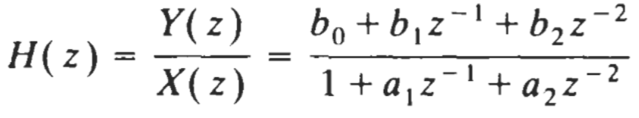
Canonical Simulation
(First form)
x[n]
y[n]
BLG354E - İTÜ Faculty of Computer Engineering and Informatics - Üstündağ

Slide 8
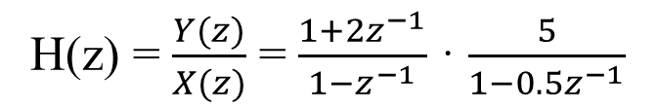
Programming of Cascaded sub-systems
H(z) = $\frac{Y(z)}{X(z)}$ = $\frac{1+2z^{−1}}{1−z^{−1}}$ · $\frac{5}{1−0.5z^{−1}}$
x[n]
B
C
D
E
y[n]
+
z⁻¹
2
+
5
+
z⁻¹
A
Input X
A=X+B
C=A+2B
D=5C+0.5E
Y=D
Output Y
E=D ; z⁻¹
B=A ; z⁻¹
Return
0.5
@T_{s}
t=k·T_{s}
BLG354E - İTÜ Faculty of Computer Engineering and Informatics - Üstündağ

Slide 9
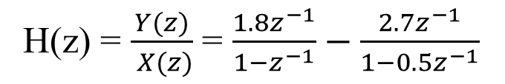
Programming of Parallel sub-systems
H(z) = $\frac{Y(z)}{ X(z)}$ = $\frac{1.8z^{−1}}{1−z^{−1}}−\frac{2.7z^{−1}}{1−0.5z^{−1}}$
1.8
+
A
z⁻¹
B
x[n]
y[n]
+
Input X
A=1.8X+B
C=-2.7X+0.5D
Y=B+D
Output Y
B=A ; z⁻¹
D=C ; z⁻¹
Return
- 2.7
C
z⁻¹
D
+
@T_{s}
t=k·T_{s}
0.5
BLG354E - İTÜ Faculty of Computer Engineering and Informatics - Üstündağ

Slide 10
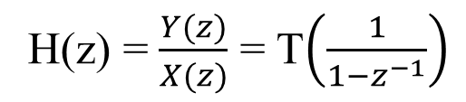
Example:
Digital integrator without delay:
H(z) = $\frac{Y(z)}{X(z)}$ = T$\left(\frac{1}{1−z^{−1}}\right)$
x[n]
y[n]
T
+
A
Input X
Y=T×X+A
Output Y
A=Y ; z⁻¹
Return
z⁻¹
@T_{s}
t=k·T_{s}
Initial condition: If y(kT)=0 for k<0 then A=0
Y[n]=y(kT)=T[x(0)+x(T)+x(2T)+…+x(kT)]
1) Simulate the system for x[n]=u[n-2]-u[n-4]+δ[n-3]
2) What are the differences between integrator with and without Delay ?
3) Write the pseudo code for digital integrator with delay
BLG354E - İTÜ Faculty of Computer Engineering and Informatics - Üstündağ

Slide 11
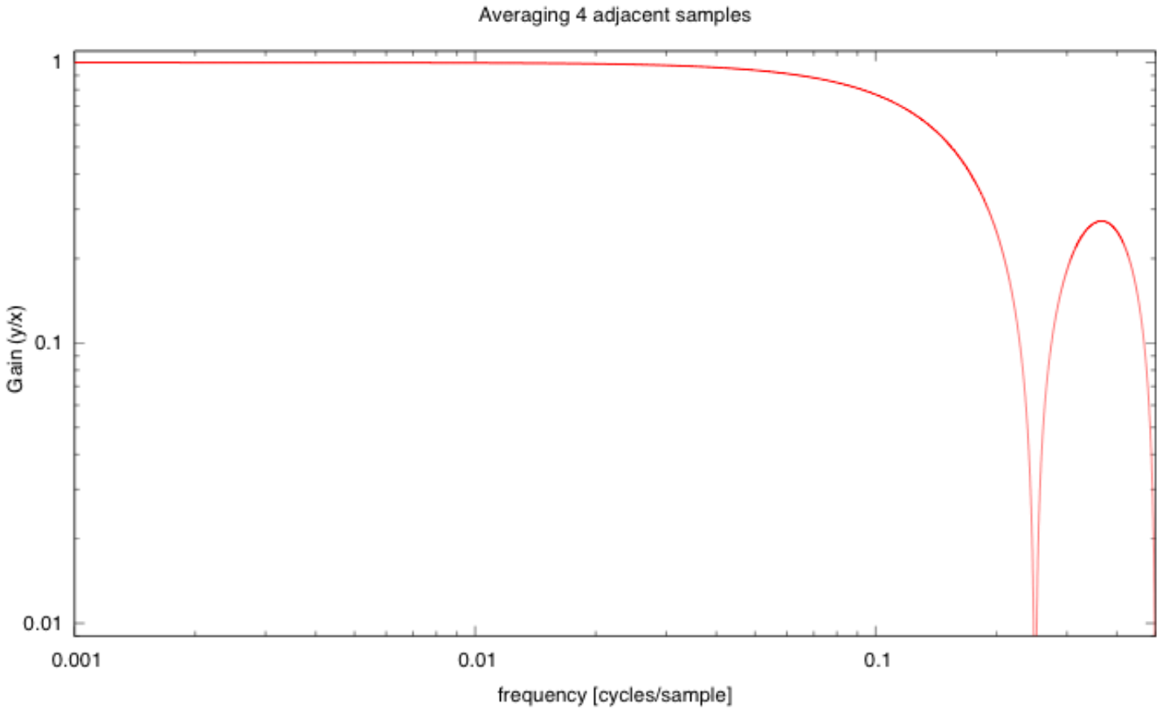
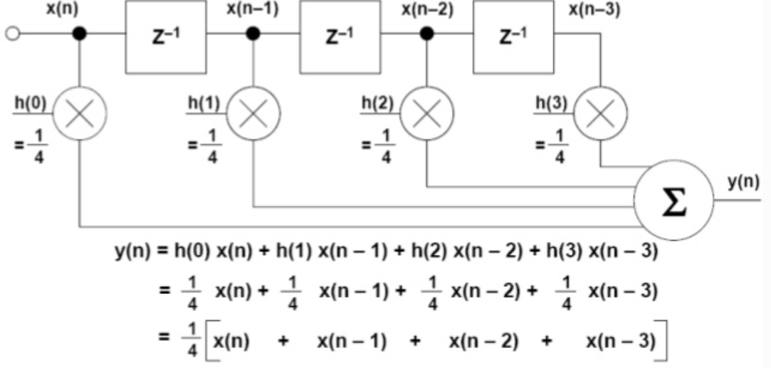
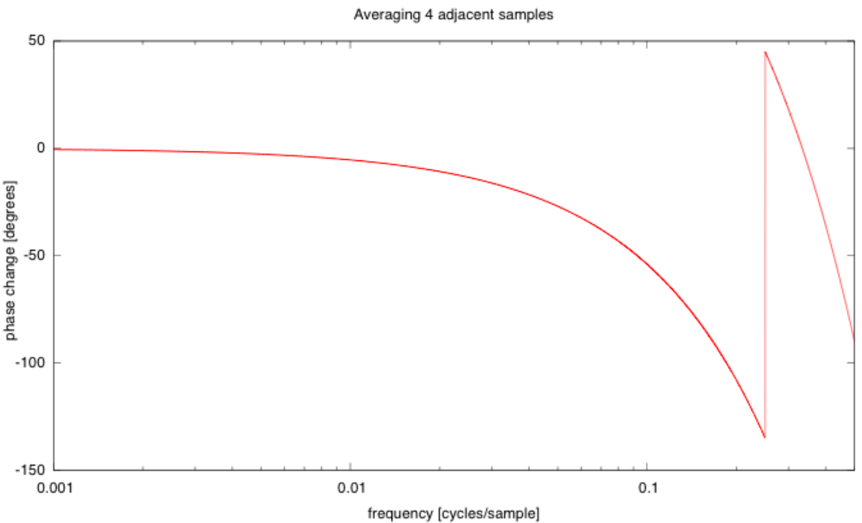
Additional concerns:
0.707
BW
0.11536
cycles per sample
0.36614
z=e^{jω} , f=ω/2π
Question:
Design and Analysis problem
How can we find the discrete time transfer function and write
the real time computational code
If real time characteristic of the target system is given first
(e.g. if BW is given how to find h(i))
gnuplot source code for the gain plot
BLG354E - İTÜ Faculty of Computer Engineering and Informatics - Üstündağ

